Slide 1

Introductory Computer Networking and IT Security
Week 8

Slide 2
Agenda
Introduction to WAN
HDLC (High level data link control protocol)
PPP (Point-to-Point Protocol)
Introduction to Frame relay technology

Slide 3
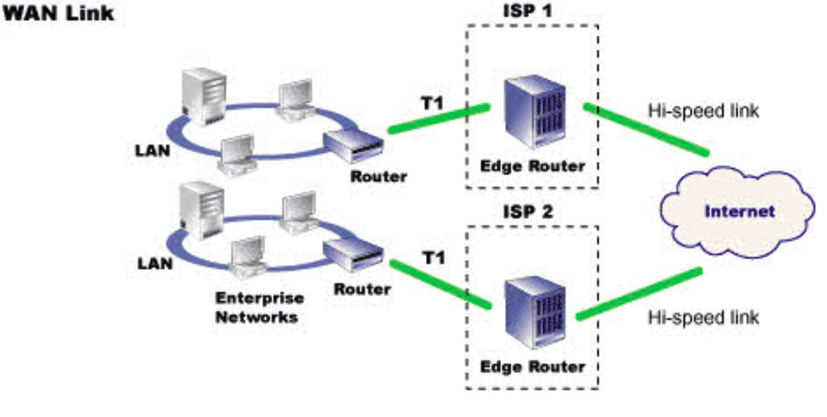
WAN
A wide area network is a telecommunications network that extends over a large geographical area for the primary purpose of computer networking. Wide area networks are often established with leased telecommunication circuits.

Slide 4
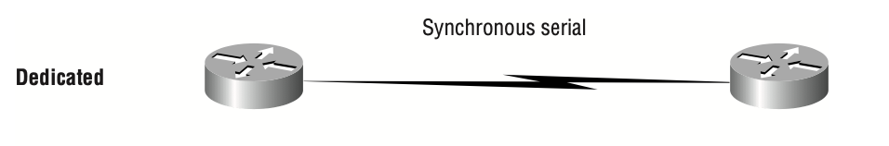
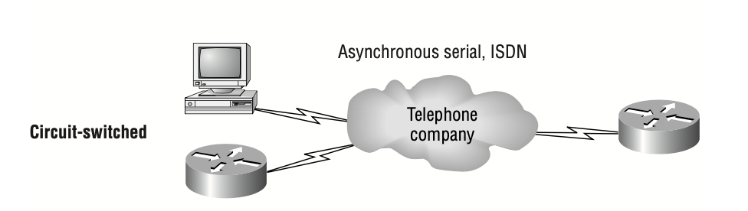
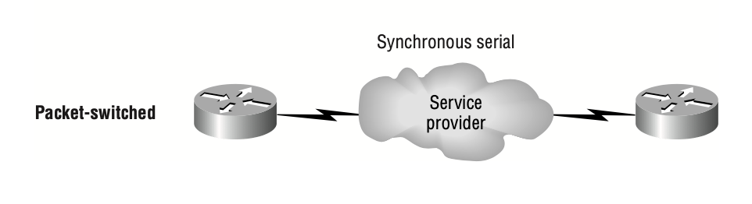
WAN Connection Types

Slide 5
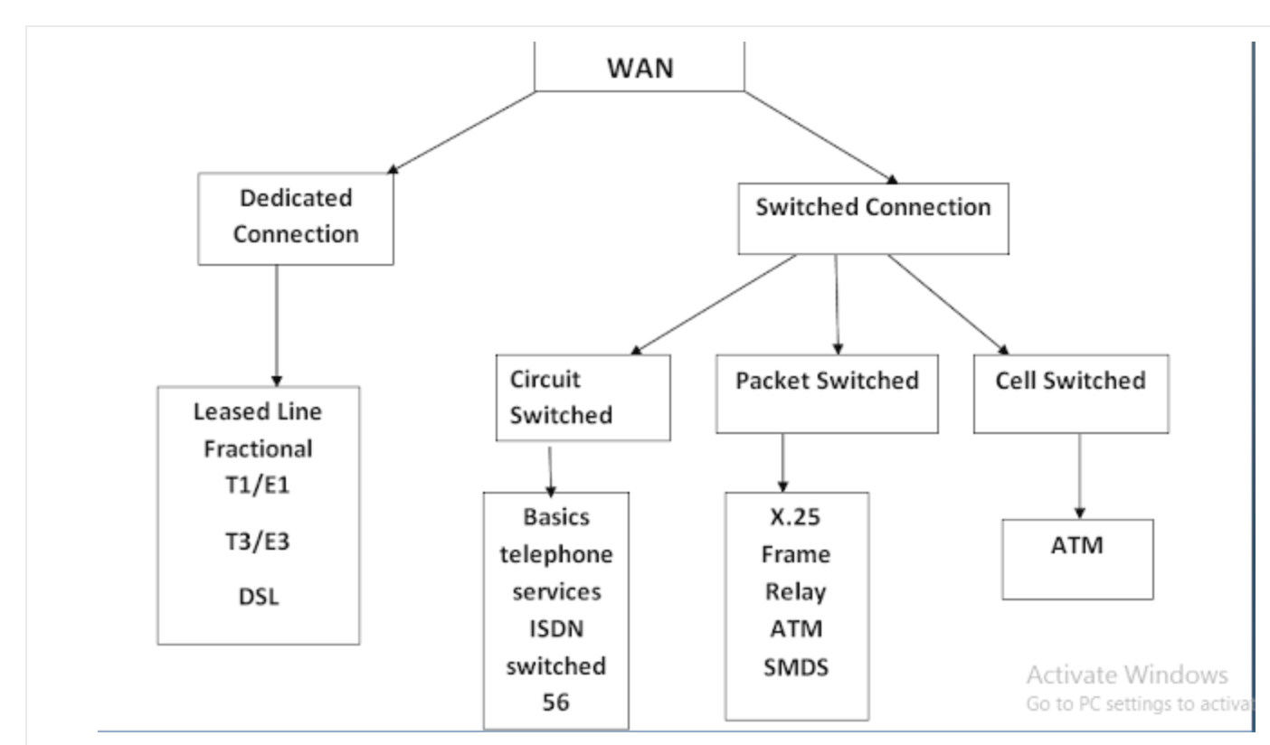
WAN Connection Types

Slide 6
Dedicated Connections
A dedicated line is a communications medium or other facility dedicated to a specific application, in contrast with a shared resource such as the telephone network or the Internet is called dedicated connection.
1.Leased Lines:
It is a dedicated point to point connection which provides pre-establish WAN communication path through ISP to remote destination is called as leased line. It provide very high speed data transmission up to 64Gbps.It is very expensive.

Slide 7
Dedicated Connections
2.Digital Subscriber Line (DSL):
It is a provide connection between ISP to a customer through telephone line.
It is a broadband technique which provides same upstream and downstream.
3. Asymmetric Digital Subscriber Line (ADSL):
Asymmetric digital subscriber line is type of digital subscriber line technology a data communication technology that enables faster data transmission over the copper telephone line rather than conventional voice modem used.
It is some like as digital subscriber line but only difference is that upstream

Slide 8
Switched Connections
There are three types of switched connection are as follows:
Circuit Switched Network
Packet Switched Network
Cell Switched Network

Slide 9
Circuit switching
In circuit switches network, every time before transferring data over the WAN, new connection get establish after data transfer over the connection get closed.
In this technique generally data is transferred through single connection or single route.

Slide 10
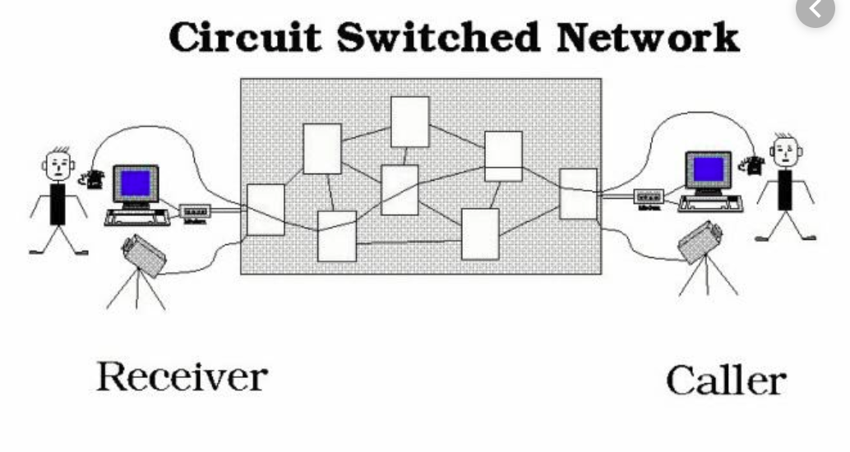

Slide 11
Packet switching
In packet switched network, uses virtual connection for transferring data, it for transferring data create connection on first data transmission and used it as a permanent connection.
It is faster than circuit switched network.
It is used for multi path communication.

Slide 12
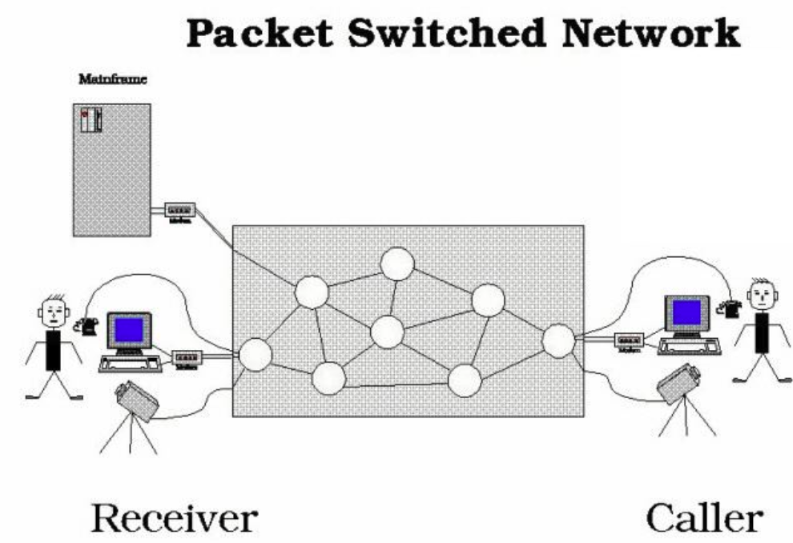

Slide 13
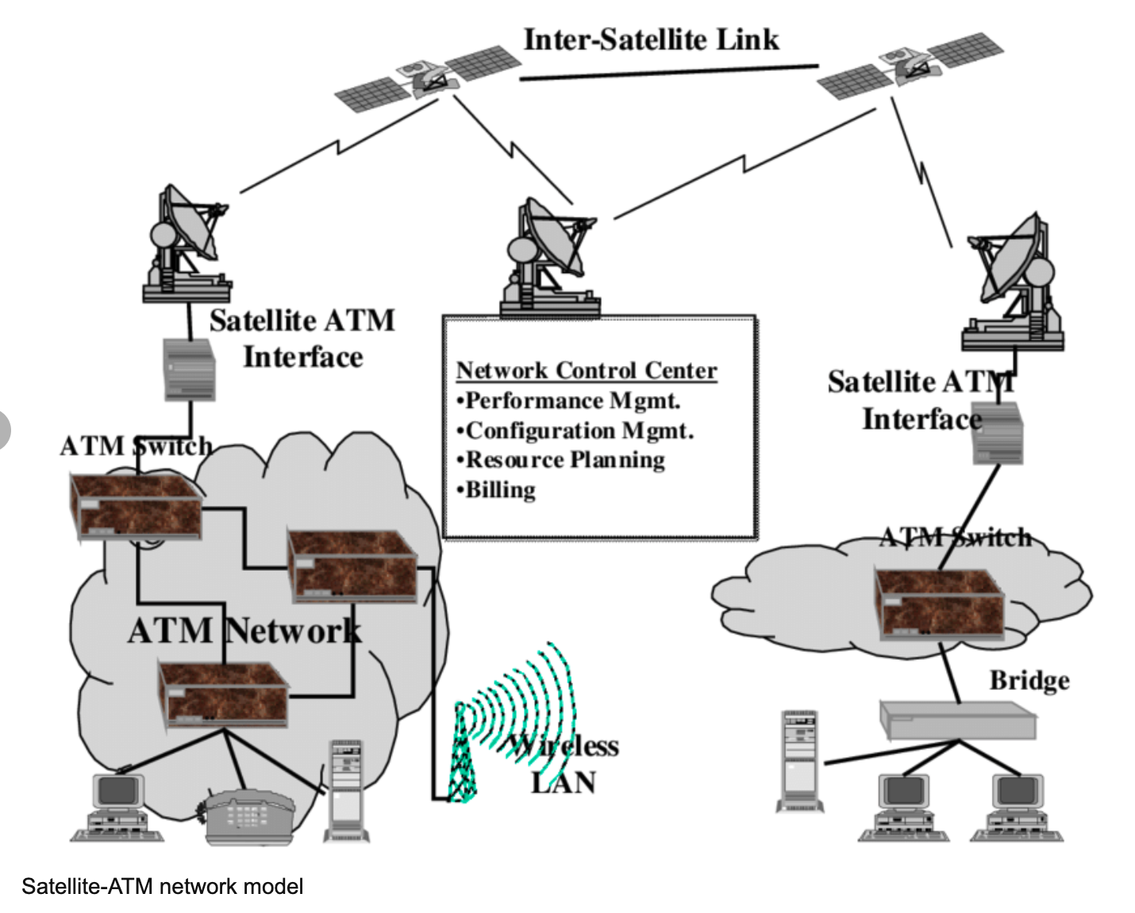
Cell Switched Network
In this type of network data transfer in fixed size cell that is 53 bytes.
Its example as ATM.

Slide 14
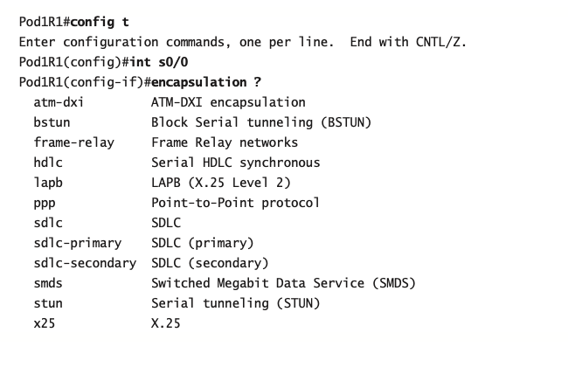
WAN Support
HDLC
PPP
Frame relay
ATM

Slide 15
High-Level Data-Link Control (HDLC) Protocol
HDLC protocol is a popular ISO-standard, bit-oriented Data Link layer protocol.
It specifies an encapsulation method for data on synchronous serial data links using frame characters and checksums.
HDLC is a point-to-point protocol used on leased lines.
No authentication can be used with HDLC.
HDLC is the default serial encapsulation on Cisco serial links

Slide 16
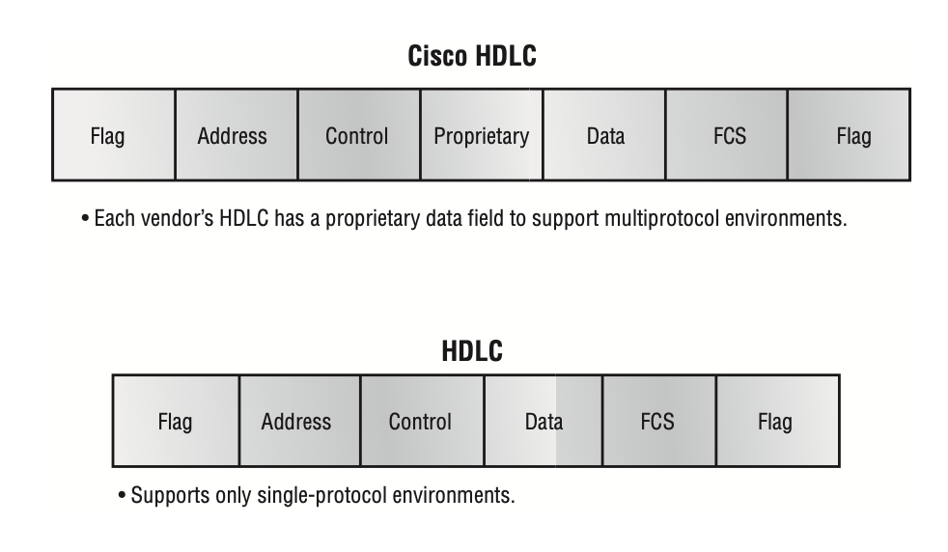

Slide 17
Point-to-Point Protocol (PPP)
PPP is a Data Link layer protocol that can be used over either asynchronous serial (dial-up) or synchronous serial (ISDN) media.
It uses the LCP (Link Control Protocol) to build and maintain data-link connections.
Network Control Protocol (NCP) is used to allow multiple Network layer protocols (routed protocols) to be used on a point-to- point connection.
The basic purpose of PPP is to transport layer 3 packets across a Data Link layer point-to-point link.
It is non-proprietary, which means that if you don’t have all Cisco routers.

Slide 18
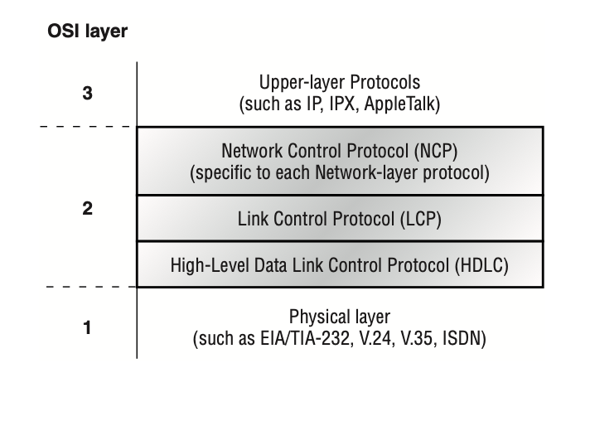

Slide 19
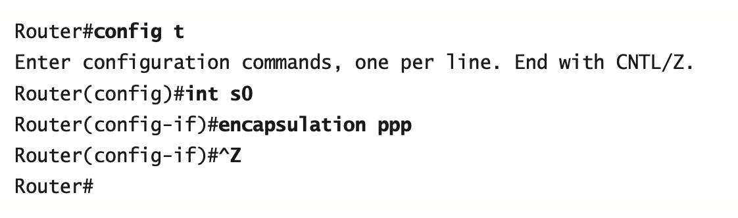
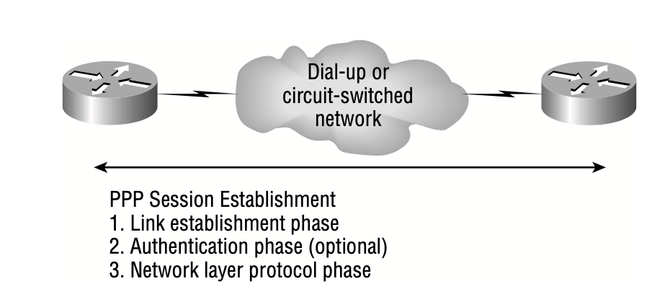
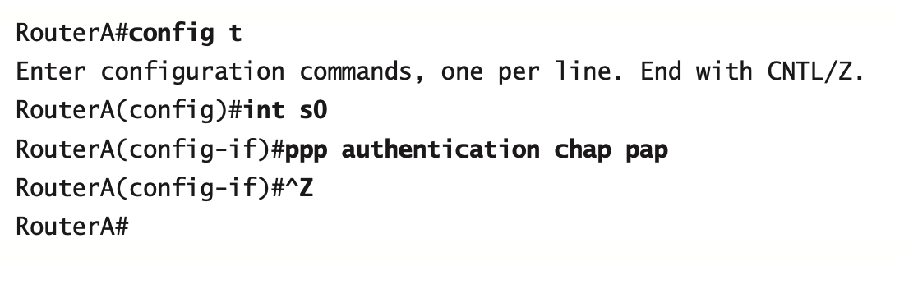
Configuring PPP on Cisco Routers

Slide 20
Frame Relay
Frame Relay, by default, is classified as a non-broadcast multi-access (NBMA) network, which means that it does not send any broadcasts, such as RIP updates, across the network by default.
It can be significantly more complex and versatile, which is why it’s often represented as a “cloud” in networking graphics.
Frame Relay provides a packet-switched network to many different customers at the same time.

Slide 21
Frame Relay
CIR The maximum bandwidth of data guaranteed to be delivered. However, in reality, this is the average amount that the service provider will allow you to transmit.
Access rate The maximum speed at which the Frame Relay interface can transmit.

Slide 22
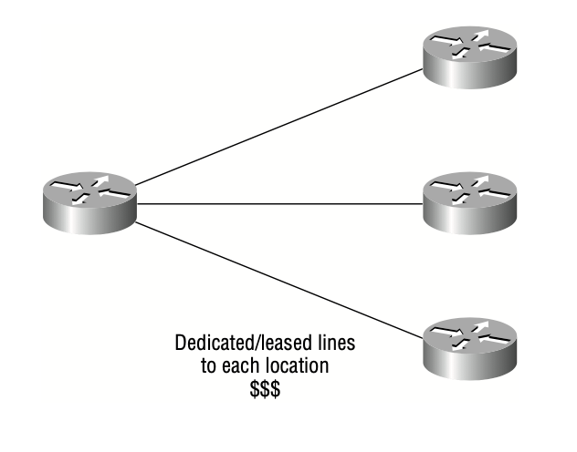
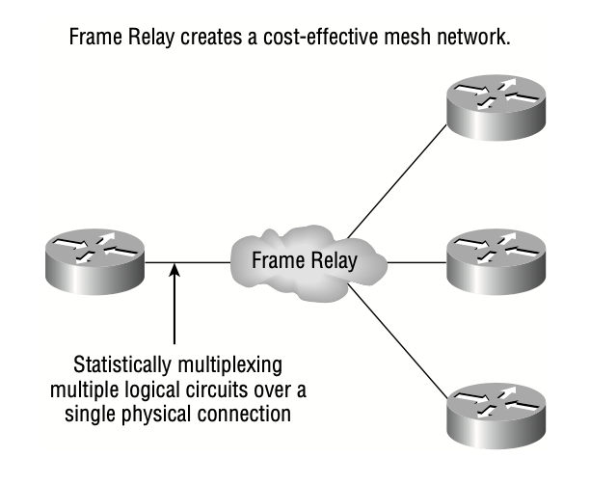

Slide 23
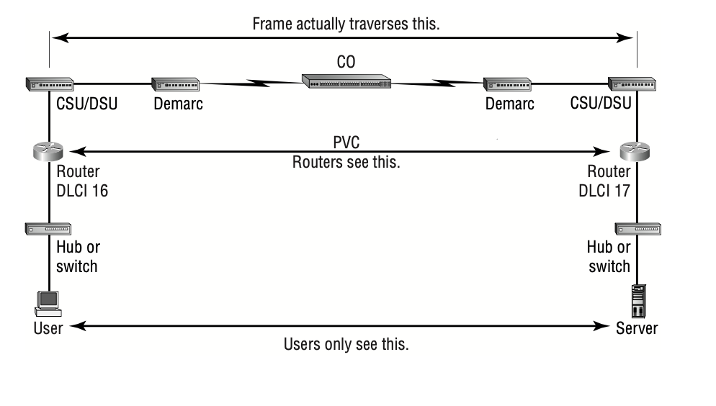
Frame Relay Technology

Slide 24
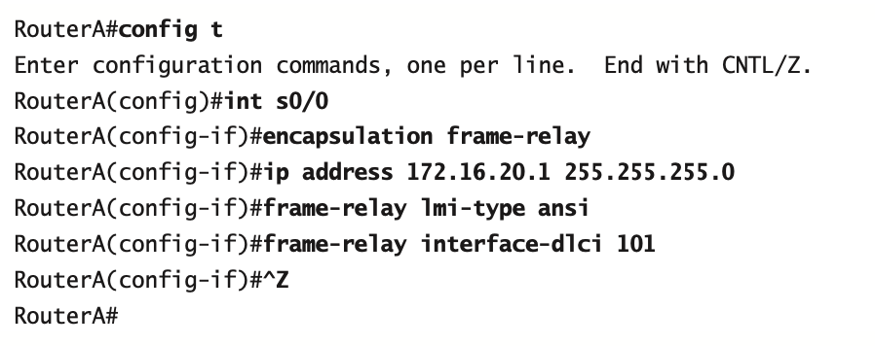
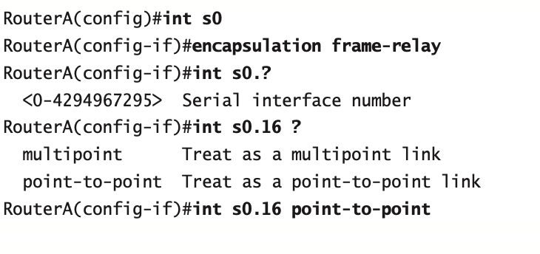
Frame Relay Implementation and Monitoring

Slide 25
Thank you

